Slide 1
Majlis Ansarullah Monthly Meeting
Feb 2017
This slide deck contains images licensed for the purpose of this presentation only.
No one is permitted to use the images for any other use, without prior permission.

Slide 2
AGENDA
Recitation of the Holy Quran (4:59)
Pledge
Reminders: Recitation of HQ and Congregational Prayers
Monthly topic: Are we giving our advices with absolute honesty and sincerity?
Health topic: Regular Health Exam
National Reminders/announcements
Local Reminders/announcements
Dua

Slide 3
It’s a blessing to do Waisyat!
The Promised Messiah (as) said,
“I pray that God may bless it and that He may make this very piece of land Bahishti Maqbarah and make it resting place of those members of the Jama‘at who are pure of heart and who have in reality given precedence to Faith over the world and who have renounced love of the world and submitted themselves to God and who have brought about in themselves a holy change and who have, like the disciples of the Holy Prophet^{saw}, set example of faithfulness and truthfulness. Amen, O Lord of the worlds.”
(Risala Al-Wasiyyat)

Slide 4
Why read the Holy Quran regularly?
Recitation of the HQ attracts Mercy
Hazrat Abu Hurairah relates that the Holy Prophet (sas) said: whenever people gather together in of the houses of Allah for recitation of the Quran and teaching it to one another, comfort descends upon them, mercy covers them , angles spread their wings over them and Allah make mention of them to those around him.
Muslim

Slide 5
Watching Our Congregational Salat!
Combining Prayers or Not Offering Congregational Prayers
Not offering Salat in mosque or combining Salat becomes that much more perilous on a communal level when we note that children are losing the significance of congregational Salat and some even say that Salat is offered three times a day (due to combining). Urgent reflection and planning is required everywhere in this regard otherwise this could become a communal ill for our next generation! And one ill leads to another and faith remains all but in name with its spirit lost. There is great need to make endeavors to avoid spiritual illness.
(Friday Sermon of Khalifatul Masih V (aba), February 13, 2015)

Slide 6
Are We Giving Our Advices With Absolute Honesty and Sincerity?

Slide 7
Click to listen the recitation
[4:59] Verily, Allah commands you to make over the trusts to those entitled to them, and that, when you judge between men, you judge with justice. And surely excellent is that with which Allah admonishes you! Allah is All-Hearing, All-Seeing.

Slide 8
What does this verse teach us about giving honest advices and sincere opinions?
Share your thoughts

Slide 9
Guidance from the Holy Prophet (saw)
The Holy prophet (saw) said that one who is consulted is a trustee and one whose seeks his consultation and he gives it to him without due integrity betrays him.
(Musnad Imam al-A’zam)

Slide 10
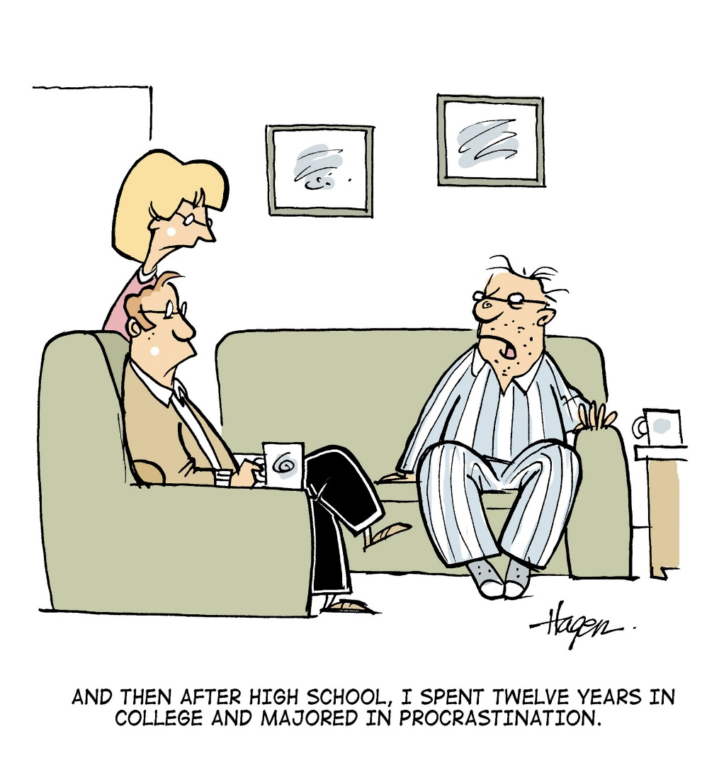
Discussion I
You’re a respected and successful doctor in your Jama’at. A fellow nasir calls you one evening. His son is struggling in high school and lacks direction regarding his future. The nasir pleads with you to let his son know about all the great things about being a doctor and to convince him to pursue medicine. What you should do?

Slide 11
Option 1: You should call his son and let him know about how the medical profession helped you financially as well as made you better able to serve the Jama’at.
Option 2: You should tell the father that you are not a career planner and you feel you are not qualified to advise his son.
Option 3: You should tell the father that you will talk to his son, but you may not necessarily advise his son to become a doctor.
Option 4: any other response

Slide 12
Guidance from HKM IV (ra)
Hadhrat Khalifatul Masih IV (ra) said,
Hadhrat Jabir (ra) narrates that Prophet Muhammad (saw) said that when someone asks his brothers’ counsel then it is incumbent upon his brother to give him a sound advice. The one whose suggestion is sought is a trustee. (Sunan Ibn Maja, Kitabul Adab, chapter Almustesharo Momin). So the advice ought to be absolutely honest that emanates from the bottom of your heart and the burden of giving advice be such as if you are carrying a heavy load of trust.
Friday sermon delivered on 23 February, 2001

Slide 13
Discussion II
Ansarullah Shura elections are tomorrow. Your majlis elects only one member to go to Shura other than the Zaim. The Zaim owns a successful business in the area, which has helped him to employ many of the Ansar there. In previous years, the Zaim’s cousin, who is also an employee at the Zaim’s business, is elected as the Shura representative. This cousin is a very active nasir and helps the Zaim out the most with Majlis work.
There is also a man in his 50’s who has recently immigrated from Ghana. As a taxi driver, he works odd hours and is not well-off. However, he can be found at the masjid whenever he is free. You’ve noticed that he makes it a point to offer Jummah regularly. Due to language barriers, no one talks with him too much.

Slide 14
What’s the best approach?
Option 1: Nominate the Zaim’s cousin.
Option 2: Nominate the Ghanian brother.
Option 3: Don’t nominate anyone. But if the Ghanian brother is nominated, then vote for him.
Option 4: any other response.

Slide 15
Guidance from Huzur (aba)
Hadhrat Khalifa tul Masih V a.b.a. said in a Friday sermon dated March 24, 2006,
said representative for the Shura are appointed on the basis of compliance to the Nizam e Jama’at, financial sacrifice and worship of God. This puts a great responsibility on the members of the Community to appoint representative for Shura on the basis of taqwa rather than personal friendship or relation. Huzur^{aba} said these people are prospective advisors to the Khalifa therefore much care is needed and those who clearly and evidently appear undeserving or those who seek self-promotion should not be chosen. To the representatives Huzur^{aba} said their responsibility is not just for the two or three days of the Shura conference but for the whole year until the next set of representatives are chosen. Therefore they need to continually self-reflect; they ought to be sincere worshippers of God who stands firm on taqwa and when no clear guidance is found in the Holy Quran or the Sunnah, they seek Allah’s guidance through prayer.

Slide 16
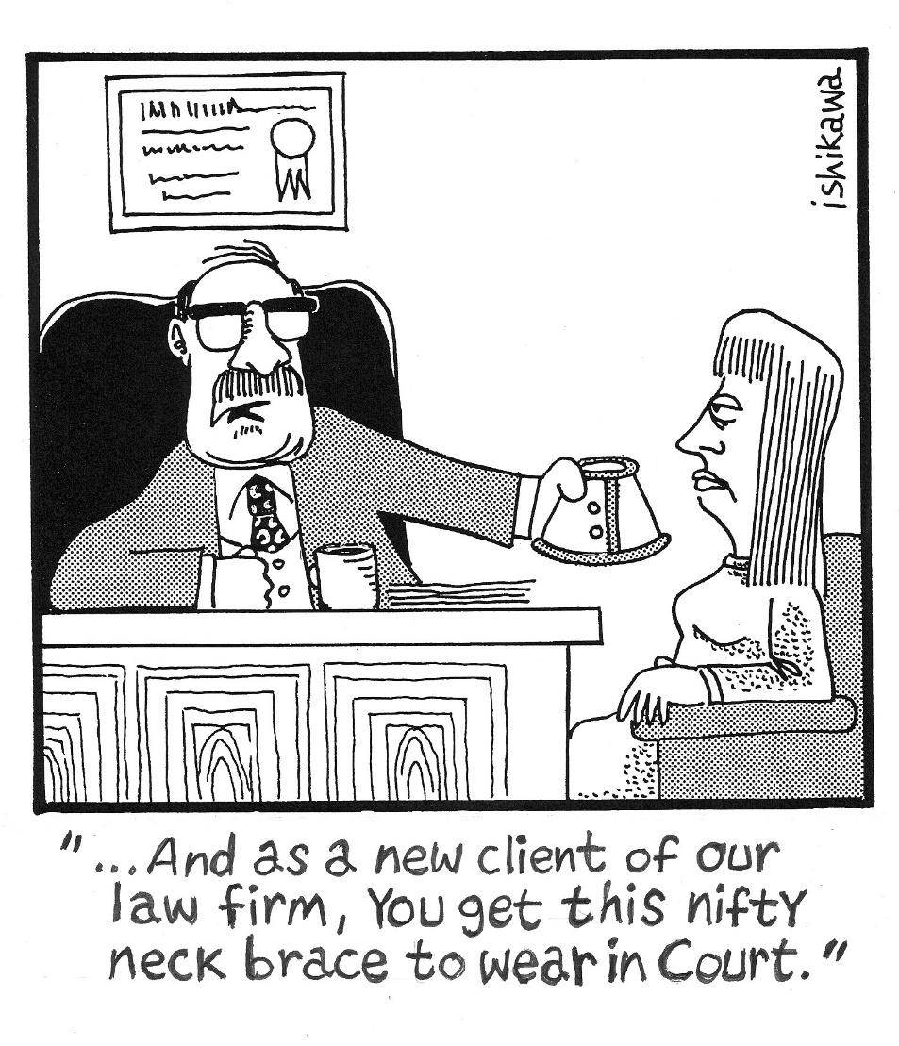
Discussion III
You and your brother-in-law own a very profitable business that has helped provide for both of your families. However, you’ve always noticed that your brother-in-law sometimes uses the company credit card for personal expenses. More recently, you found that he has been misreporting revenues to reduce the amount of taxes to be paid. You’ve shared your misgivings with your brother-in-law in the past, but he tells you he knows how small businesses work and this is all okay.
While sitting in the office one day, a government official walks in. He explains to you that the IRS have found major discrepancies in your company’s accounting and charges you and your brother-in-law with fraud. What you should do?
Notes:
Giving honest opinion when under challenges … e.g., fearful sitution

Slide 17
What’s the best approach?
Option 1: Hire a good lawyer. Follow any loopholes he suggests.
Option 2: Hire a good lawyer. But tell him you want to come clean.
Option 3: Hire a good lawyer for yourself. Tell him it’s all your brother-in-law’s doing.
Option 4: any other response.

Slide 18
Guidance from Huzur (aba)
The Promised Messiah (on whom be peace) said regarding honesty: ‘Fact is that insight is a good thing, it gives man an inherent understanding about another’s honesty. There is courage and valor in honesty while a liar is a coward. One whose life is embroiled in impurity and foulness is always frightened and cannot compete. He cannot express his honesty with courage and valor like a truthful person can and cannot give evidence of his purity.
(Translated from Malfuzat, Vol. 10, p. 252)

Slide 19
A Short Video from Friday Sermon, Jun 21, 2013

Slide 20
Translation of the Video
Man faces difficulties in worldly and religious matters. If one is steadfast in truthfulness and in Taqwa (righteousness) and is mindful of one’s deeds, then with the God’s Grace, difficulties will be removed. As Promised Messiah (as) said, that sometimes speaking the truth can practically put one in difficulties, but if one is completely honest then there is no need to fear. Those difficulties will disappear. This does not happen only with the enemies but sometimes speaking the truth to one’s own friends can create difficulties. This is because there are people with different dispositions in our own circle. Sometimes there are people with lesser degree of Taqwa in one’s circle which is why sometimes one can face difficulties. For example, these days Jamaat elections are taking place in the world and I sometimes get complains from people that after voting, some office holders question the voter why they have voted for certain people. Jamaat elections are such that everyone is free to vote as they see fit and no one has the right to question the voter. If a person votes for someone in all honesty, that he feels is a suitable candidate then no office holder has the right to question that person. If, however a person has some shortcomings, then next time he may not be forthcoming lest his shortcomings and weaknesses get exposed. When a person is weak in Taqwa, then sometimes he expresses, that he is concerned that office holders will harbor resentment against him [for not voting for him]. This is all due to lack of Taqwa and lack in truthfulness. Therefore, it should always be remembered that if one expresses his opinion in all honesty, then honesty and Taqwa demands that he remains worry free. Indeed, he should keep engaged in seeking God’s Grace as if God’s Grace is there then no one can harm him.

Slide 21
Where do we stand?
اپنے جائزے لیں
Self analyze yourself, KMV
During the last month
How many times were you not 100% truthful to give your opinion at work?
How many times did you not give your 100% honest opinion in a Jamaat meeting?
How many times did you not give your honest opinion to someone in your family?
Add the three numbers together.
(Keep it to yourself.. the “score” is for you!)

Slide 22
How to Improve?
اپنے اندر پاک تبدیلیاں پیدا کریں
Bring about pious changes in yourself
0-1
Combined Score
>5
Keep praying and strive hard to be always honest and truthful at all times.
Pray and strive hard to stay away from any kind of falsehood and dishonesty.
Pray hard for yourself to stay truthful. Make a conscious effort not to lie or be dishonest at next trial.

Slide 23
Health Topic: Men’s Health

Slide 24
Health Topic: Annual Health Examination

Slide 25
What is Annual Physical Examination?
An Annual Health Examination aims at periodically assessing an individuals general health status; It is also called PERIODIC HEALTH EXAMINATION
It is a source of reassurance and an alarm system to detect conditions in early stages
Periodic Health Examination may require more than one visit to your doctor
Periodic Health Examination will consist of History, Physical Examination, blood test, EKG, Imaging and selected screening tests
Most insurance will pay for Annual or Periodic Health Examination
Many Screening Programs begin around age 40

Slide 26
What to Expect?
The most important part is the HISTORY
Personal Health History, Family History, Smoking, Drinking, lifestyle, Exercise, Nutrition, Social History, Vaccination Status
Be Proactive with good written information at hand
Be truthful and do not hide pertinent medical information from your physician. Your health belief is also very important
Physical Examination - Blood Pressure, Heart & Lung Examination, Eyes / Vision, Ear / Hearing, Urinary and Digestive Systems, Skin and Neurological Examination, Muscle and Joints, skin examination
Review of your medicines and major changes in your health status

Slide 27
How to get an Annual Exam?
You may arrange an Annual Health Examination through your family physician
May be arranged through your employer or may be required for your job
LAB WORK - Typically will consist of total blood counts (CBC). Glucose (for Diabetes) kidney function tests, cholesterol (lipid panel), routine urine test, may need EKG, Chest X-Ray, TB Skin Tests
May also include Vision and Hearing Tests
Screening Test for COLON CANCER beginning at age 50 or sooner (Stool test or Colonoscopy)
Prostate Cancer Screening - Discuss with your doctor if you have any urine symptoms or concerns
May need referral to specialists for initial or follow up of test results

Slide 28
Four Priorities for 2017
At least 50% of Tajnid to attend monthly meetings where we discuss Huzoor’s vision: “Save yourself and your families from a fire” in interactive discussions.
Bring 350+ new Ansar in Nazam-e-Wasiyat (The targets for small, medium and Large Majlis are 3, 5, and 7, respectively)
Help establish a culture of congregational Salat.
More than 50% Tajnid to attend National Ijtima.

Slide 29
Local Reminders
Dua

